Slide 1

Fingerprint-Based Access Control System for College Events
BY
THIMMAPURAM SRINIVAS CHARY [22R11A6739]
DYAVARI RAMA KRISHNA [23R15A6702]
KOKKALAKONDA AKHIL [22R11A6723]
Under the Guidance of
Mr.S.Tirupathi Rao (Associate Professor)
Department of CSE(Data Science)
Geethanjali College of Engineering and Technology
(UGC Autonomous)
(Affiliated to J.N.T.U.H, Approved by AICTE, New Delhi)
Cheeryal(V), Keesara(M),Medchal-501301.
M), Medchal.Dist.-501 301.

Slide 2
Agenda
Introduction
Problem statement
Abstract
Objective
Design
Implementation
References
Conclusion

Slide 3
INTRODUCTION
The Fingerprint-Based Access Control System for College Events is an innovative solution designed to automate and secure the process of student identification. It uses biometric fingerprint authentication to verify participants, replacing traditional manual methods that are prone to errors and duplication. The system integrates an Arduino-based fingerprint sensor for enrollment, a Python bridge script for serial communication, and a web-based interface for user management and monitoring. All user data, including ID numbers, roll numbers, and timestamps, are stored in a JSON file for easy access. This project ensures reliable, efficient, and tamper-proof access control during college events.

Slide 4
PROBLEM STATEMENT
Traditional event access and attendance systems in colleges rely on manual verification or ID cards, which are time-consuming, error-prone, and susceptible to duplication or misuse. Managing large student gatherings becomes challenging due to delays in authentication and record maintenance. To overcome these issues, there is a need for a secure, automated, and efficient system that can uniquely identify each participant. The proposed Fingerprint-Based Access Control System addresses this problem by using biometric fingerprint authentication integrated with a web-based interface to ensure accurate, real-time verification and data management for college events.

Slide 5
ABSTRACT
This Fingerprint-Based Access Control System for College Events project uses a biometric fingerprint sensor connected to an Arduino microcontroller to uniquely identify users. A Python-based communication bridge links the hardware with a web interface, allowing real-time enrollment, deletion, and monitoring of users. The system enables seamless enrollment, deletion, and record maintenance of participants, all stored in a lightweight JSON database. It provides a scalable, real-time solution for secure and efficient event management.

Slide 6

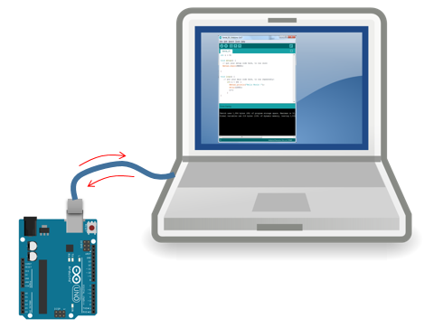

TECHNOLOGIES USED

Slide 7
OBJECTIVE
To design and implement a secure fingerprint-based access control system for college events.
To automate the participant verification process, reducing manual effort and human error.
To ensure only authorized students can gain entry, enhancing event security and management.
To store and retrieve fingerprint data efficiently using an embedded microcontroller-based system.
To record attendance automatically, providing accurate and tamper-proof participation data.
To demonstrate the use of biometric technology as a reliable and modern alternative to traditional ID-based verification methods.

Slide 8
Enrollment Module
The Enrollment Module is responsible for registering new participants by capturing and storing their fingerprint data along with their roll numbers. When a user enrolls, the fingerprint sensor scans the fingerprint, processes the image, and stores it as a digital template in both the sensor’s memory and the users.json database. The module checks for duplicates to prevent re-registration of the same fingerprint or roll number. Once successfully enrolled, the system displays confirmation on the OLED screen and updates the web interface. This module ensures secure, error-free, and unique identification for every participant in the college event system

Slide 9
Authentication Module
The Authentication Module handles the process of verifying participant identity during event access. When a participant places their finger on the sensor, the system scans the fingerprint and compares it with the stored templates. If a match is found, access is granted, and the event entry is logged automatically in the database. If the fingerprint does not match, access is denied, and an alert is displayed. This module ensures that only registered and authorized individuals are allowed to enter, enhancing security and preventing fake or unauthorized entries. It provides quick, accurate, and real-time authentication for college events.

Slide 10
Communication Module
The Communication Module acts as a bridge between the hardware (Arduino) and the software (Python and web interface). It uses serial communication to transmit data such as enrollment success, access status, and fingerprint verification results. The Bridge.py script reads serial messages from the Arduino and updates the users.json database accordingly. It also communicates these updates to the web interface for real-time display. This module ensures smooth, two-way data flow between all components, maintaining synchronization between the microcontroller and the system interface. It guarantees reliable data exchange, efficient system coordination, and instant feedback to both users and administrators.

Slide 11
Display and Notification Module
The Display and Notification Module provides immediate visual and audio feedback to users during enrollment and authentication. It uses a 0.96-inch OLED display to show system messages like “Place Finger,” “Access Granted,” or “Access Denied.” Additionally, LEDs and a buzzer indicate system responses—green light and a beep for success, red light and a buzz for failure. On the web interface, status updates and messages are displayed for administrators. This module enhances user interaction and system clarity by offering real-time updates. It helps participants understand their access results quickly while allowing event organizers to monitor operations efficiently.

Slide 12
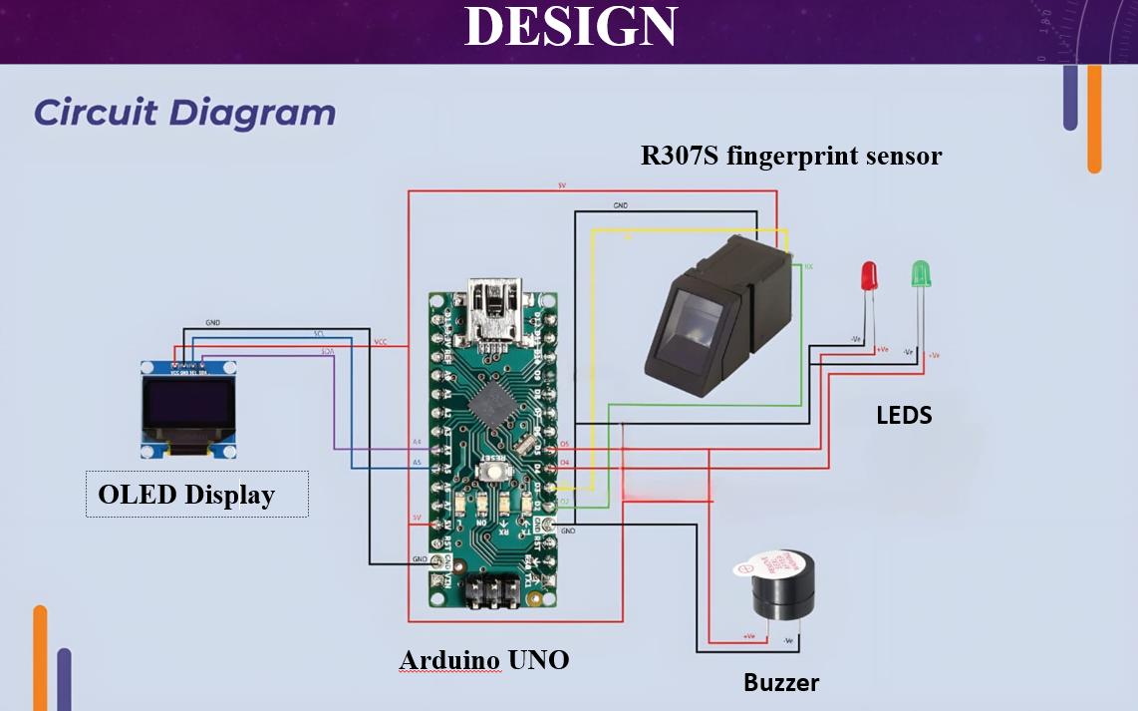

Slide 13
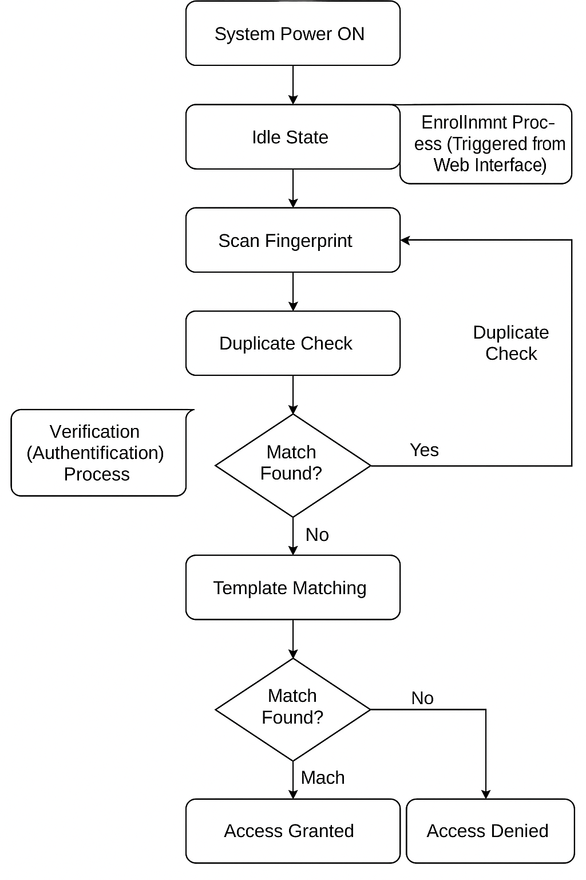
FLOW CHART

Slide 14

IMPLEMENTATION

Slide 15
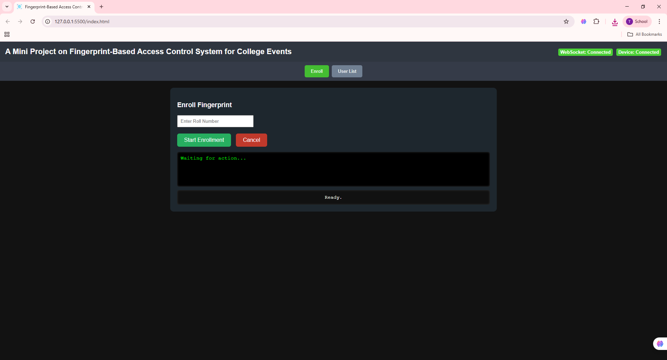
OUTPUT SCREENS

Slide 16
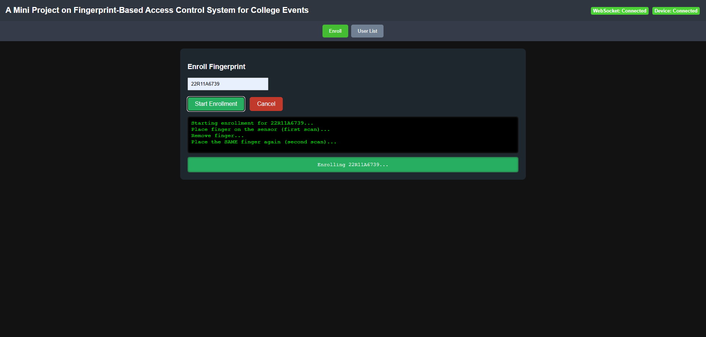
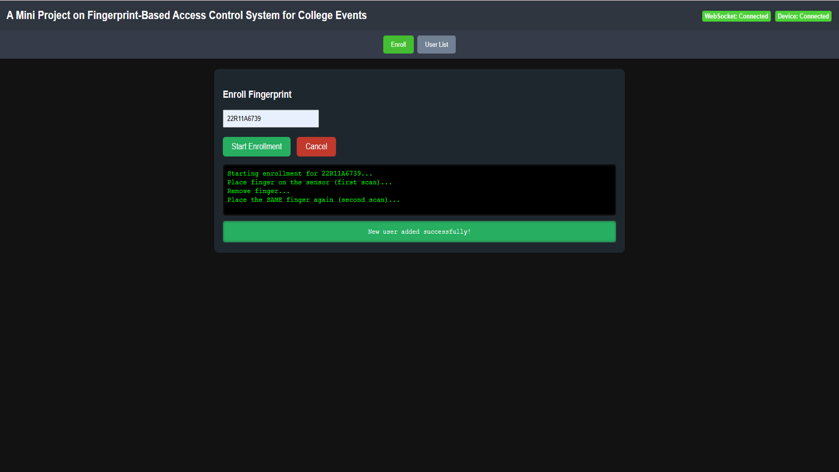

Slide 17
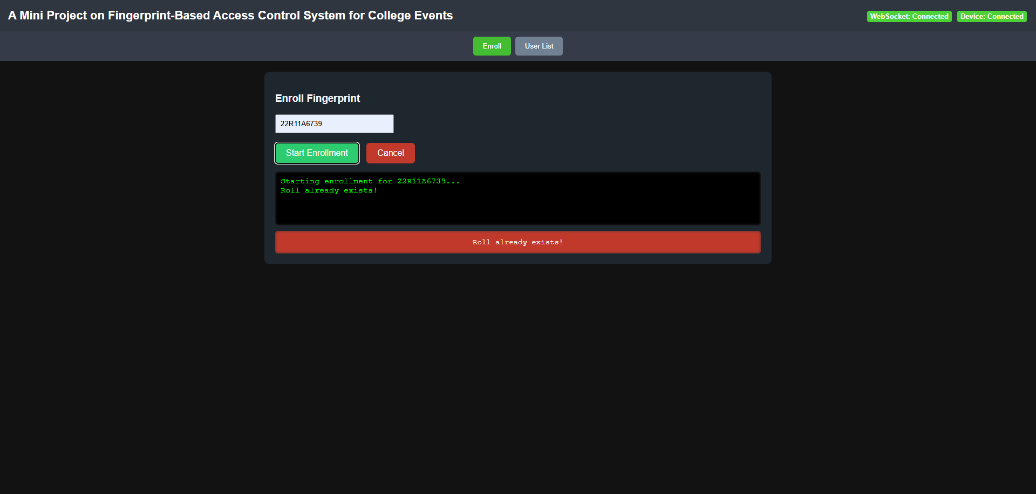

Slide 18
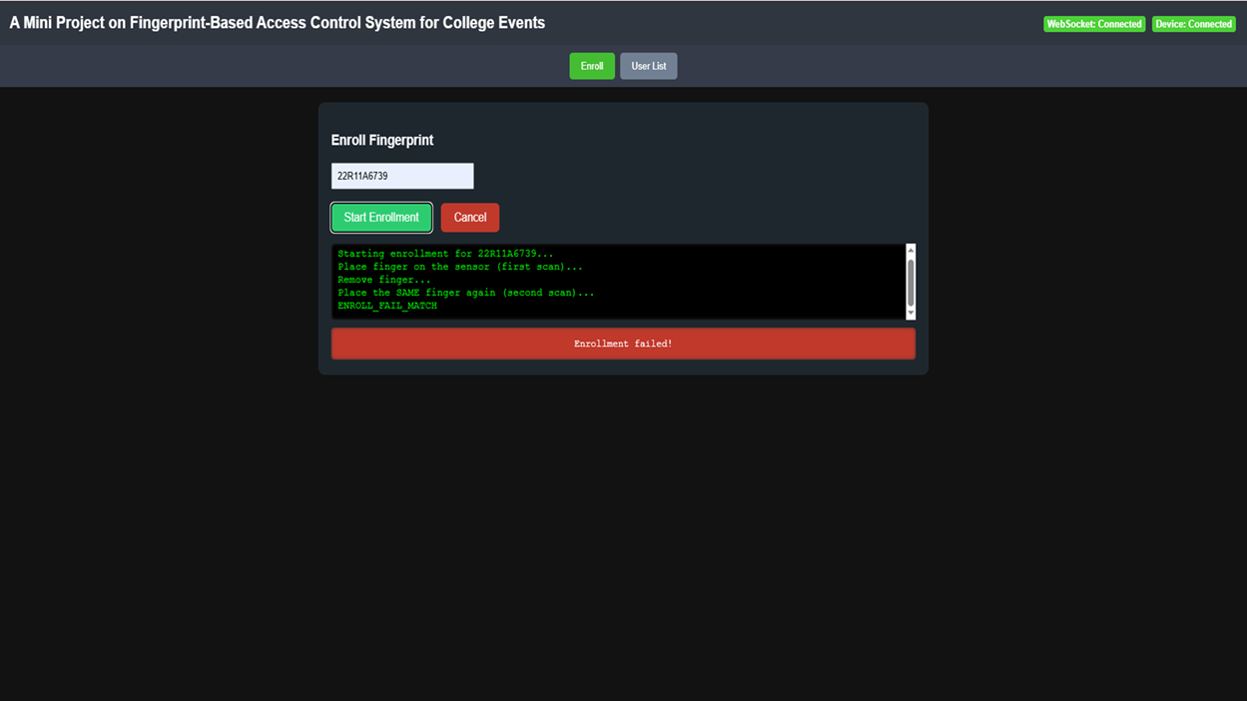

Slide 19


Slide 20


Slide 21
REFERENCES
Kumar, A., & Singh, P. (2018). Fingerprint-Based Access Control System Using Microcontroller. International Journal of Engineering Research & Technology (IJERT), Vol. 7, Issue 6.
Sharma, M., & Patel, D. (2019). Fingerprint Recognition Using Minutiae and Ridge Feature Extraction. IEEE Transactions on Information Forensics and Security.
Reddy, S., & Das, R. (2021). Automated Attendance System Using Fingerprint Biometrics. International Journal of Computer Science Trends and Technology.
Mehta, R., & Iyer, K. (2020). IoT-Based Biometric Authentication System for Smart Campus Management. IEEE Access Journal.
Carcillo, F. et al. (2019). Credit Card Fraud Detection: A Realistic Modeling and a Novel Learning Strategy. IEEE Transactions on Neural Networks and Learning Systems

Slide 22
CONCLUSION
The Fingerprint-Based Access Control System for College Events provides a secure, efficient, and automated way to manage event entry and attendance. By using biometric fingerprint authentication, the system eliminates manual verification errors and prevents unauthorized access. It integrates hardware components like the R307S sensor and Arduino with a web-based interface and JSON database for smooth operation and real-time monitoring. The system ensures fast, accurate, and user-friendly performance, making it ideal for college event management. Overall, it enhances security, reduces human effort, and promotes a more reliable, digital, and organized event access process.

Slide 23


